Slide 1
GOOD MORNING
EVERYONE !!!

Slide 2
Warm up
Question words

Slide 3
Unit 3: Peoples of Viet Nam
Lesson 3: A closer look 2

Slide 4
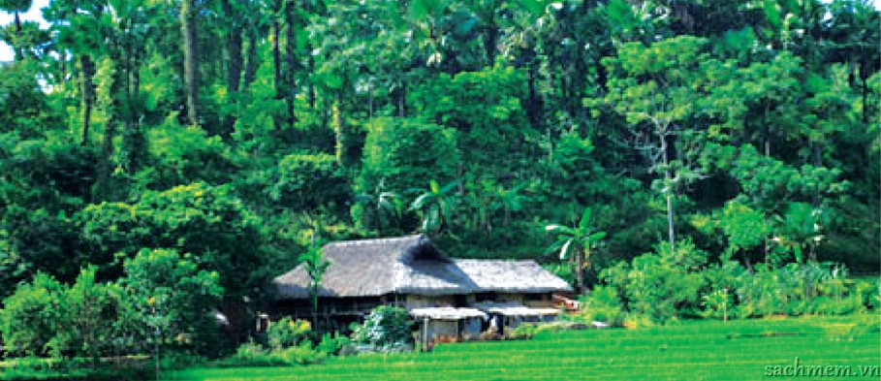
grammar
Questions: review
1. Read the passage.
In a small village in the north, there is a stilt house. In the house, a Tay family are living together: the grandparents called Dinh and Pu, the parents called Lai and Pha, and three children called Vang, Pao and Phong. Every day the grandparents stay at home to look after the house. Mr Lai and Mrs Pha work in the fields. They grow rice and other plants. Mrs Pha goes to the market twice a week to buy food for the family. Mr Lai sometimes goes hunting or cutting wood in the forests. Pao and Phong go to the primary school in the village, but Vang studies at the boarding school in the town about 15 kilometres away. He goes home at the weekend. The family live simply and they enjoy their way of life. There are a few difficulties of course. But they say they live more happily in their stilt house than in a modern flat in the city.

Slide 5
2. Now write questions for these answers.
Example: Answer → In the north.
Question → Where is the small village?
Answers:
1. A Tay family.
→ __________________________________________________________________?
2. Three children.
→ __________________________________________________________________?
3. Yes, they stay at home to look after the house.
→ __________________________________________________________________?
4. Twice a week.
→ __________________________________________________________________?
5. It is about 15 kilometres.
→ __________________________________________________________________?
6. At the weekend.
→ __________________________________________________________________?
7. They live happily.
→ __________________________________________________________________?
8. No. They like living in their stilt house.
→ _________________________________________________________________ ?
Who is living in the house
How many children do they have
Do the grandparents stay at home
How often does Mrs Pha go shopping
How far is Vang’s boarding school ? / How far is the town
When does Vang go home every week ? / When does Vang go home
How do they live
Would they like to live in a modern flat in the city ? / Would they like to live in the city

Slide 7
3. Complete the questions using the right question words.
Who
A: ______ is the class monitor?
B: Dan is.
A: ______ is the biggest house in this village?
B: The communal house (nha rong) is.
A: ______ do you think is the most interesting museum in Ha Noi?
B: The Museum of Ethnology.
A: ______ is more colourful, the Nung’s or the Hoa’s costume?
B: The Hoa’s, of course.
A: ______ is the waterwheel used for?
B: It is used to get water to the fields.
Which
Which
Which
What

Slide 8
4. Work in pairs. Make questions and answer them.
Who/ do/ shopping/ your family?
____________________________________________________________
Who/ principal/ our school?
____________________________________________________________
Which subject/ like better/ English/ Maths?
____________________________________________________________
What/ most important festival/ Viet Nam?
____________________________________________________________
Which ethnic group/ larger population/ Khmer/ Cham?
____________________________________________________________
Who does the shopping in your family?
Who is the principal of our school?
Which subject do you like better, English or Maths?
What is the most important festival in Viet Nam?
Which ethnic group has a larger population, the Khmer or the Cham?

Slide 9
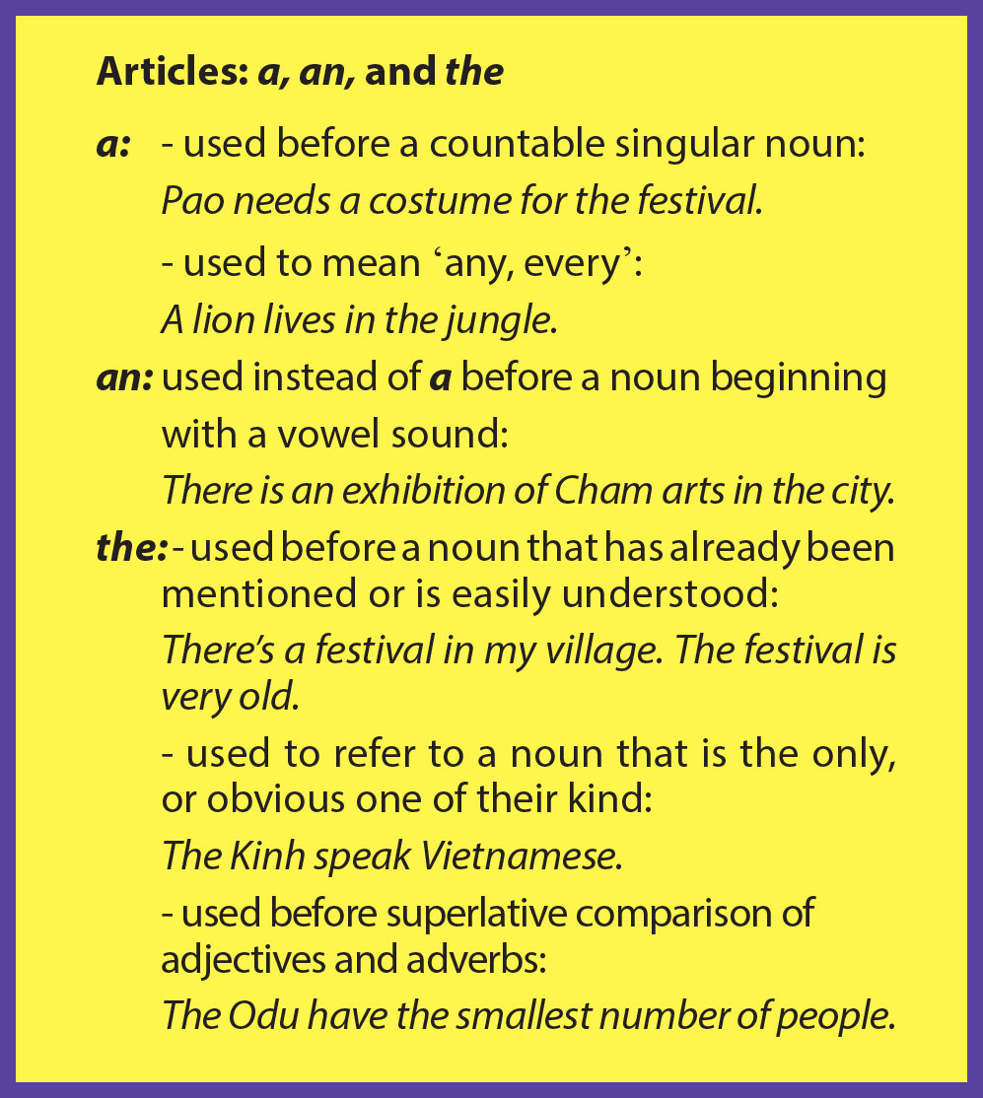

Slide 11
5. Circle the correct article to finish the sentences.
Viet Nam is a / an / the multicultural country with 54 ethnic groups.
Among the ethnic minorities, a / an / the Tay have the largest population.
A / An / The ethnic minority people in the village are very friendly.
The Lao are one of a / an / the many Thai-speaking peoples.
The Lolo women’s dress is among a / an / the most striking styles of clothing worn by ethnic peoples.
The Yao have a / an / the rich culture of folk literature and art, with tales, songs, and poems.

Slide 12
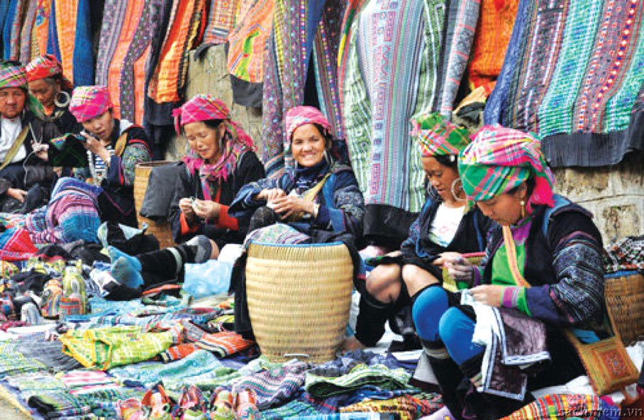
6. Insert a, an or the in each gap to finish the passage.
When you travel to a north-west mountainous region and you want to have (1) ___ great time, you can go to (2) ______ local open-air market.(3) ___ sight there is beautiful. Local people in colourful clothing are smiling as they sell or buy their local products. The goods there are diverse. You can buy all kinds of fruit and vegetables, which are fresh and cheap. You can also buy a nice costume of (4) _______ ethnic group you like. If you don’t want to buy anything, just go round and enjoy looking. You can also taste some specialities of (5) ___ local people sold right there at the market. I am sure you will have (6) ___ unforgettable time.
a
a / the
The
an / the
the
an

Slide 13
Home work
Search the google to do EX 1, 2, 3 in Communication
Find the information of each group in EX 2: location, food, lifestyle, costume, festivals, weddings…( each group does one group )

